Slide 1
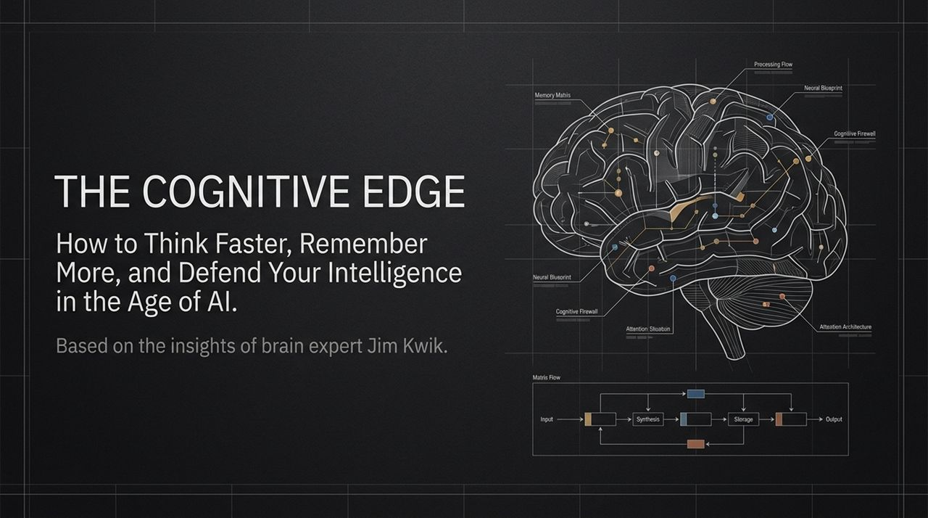
Notes:
Welcome everyone. Today, we are discussing one of the most critical survival skills of our modern era: The Cognitive Edge.
We live in an age where Artificial Intelligence can write code, draft essays, generate art, and process millions of data points per second. Naturally, this brings up an unsettling question: As technology gets smarter, what happens to human intelligence? Are we upgrading our capabilities, or are we inadvertently letting our minds atrophy?
Today’s framework is deeply inspired by world-renowned brain performance expert Jim Kwik, who has spent over three decades helping top executives, Olympic athletes, and performers optimize their mental software and hardware. Kwik often shares a deeply personal story: after suffering a severe head injury at five years old, he struggled for years in school. A teacher once pointed at him and labeled him 'the boy with a broken brain.' For a decade, that single label became his mental limit. He eventually realized that his primary limitation wasn't his physical injury, but the internal narrative he was running in his head.
Over the course of this session, we will break down the exact mechanics of how your brain operates under pressure, how to prevent 'going blank' during high-stakes moments, how to partner with AI without surrendering your critical thinking, and how to build a rock-solid cognitive command center. Let’s dive in.
https://www.youtube.com/watch?v=n43LkALyK-g

Slide 2
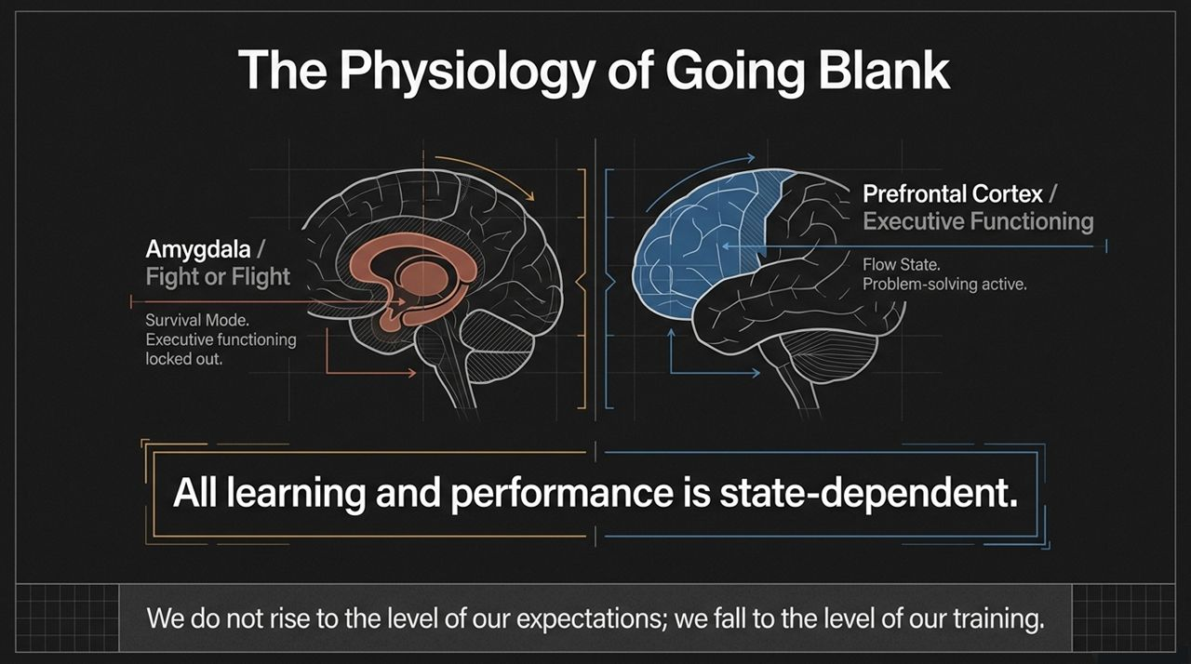
Notes:
Have you ever walked into a high-stakes presentation, a crucial negotiation, or an important meeting, and suddenly your mind went completely blank? You prepared for hours, yet you couldn't access a single line of what you intended to say.
That isn't a memory failure; it is a physiological hijacking. Look at the two brain states on this slide:
On the left, we have the Amygdala, the primitive center responsible for fight-or-flight responses. When you experience perceived threat—whether it's an intimidating audience or high pressure—your body floods with stress hormones like cortisol and adrenaline. When you are in fight-or-flight mode, your brain prioritizes immediate physical survival. It locks out higher-level executive functions because running away from a predator doesn't require complex creative problem-solving.
On the right is your Prefrontal Cortex. This is where executive functioning, flow state, creative problem-solving, and quick verbal recall reside. When you are calm and centered, you have full access to this region.
As Jim Kwik emphasizes: 'All learning and performance is state-dependent.' If you are in an anxious state, your cognitive retrieval plummets. Remember: We do not rise to the level of our expectations; we fall to the level of our training. If you haven't trained your state management under pressure, your brain will default to amygdala hijacking every single time.

Slide 3
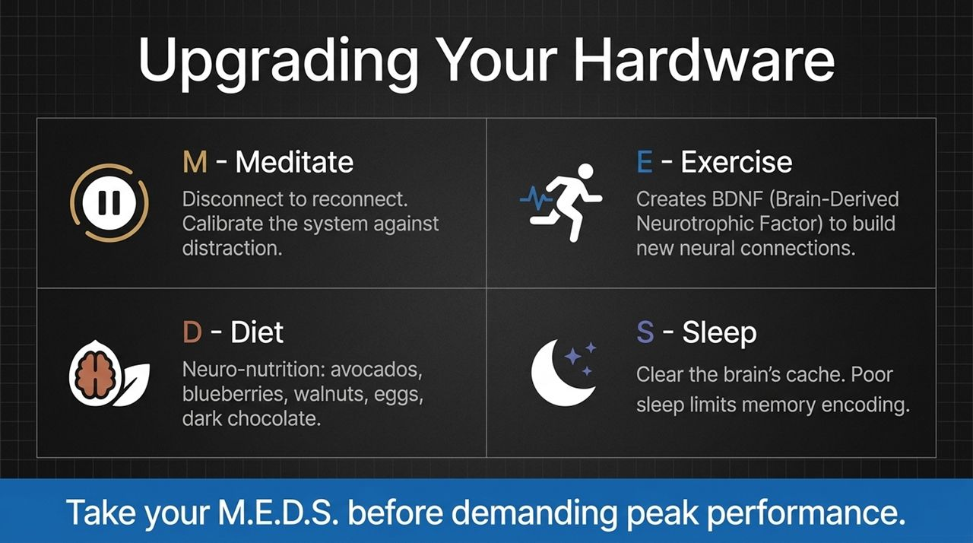
Notes:
If you want peak software performance from your mind, you first have to optimize the underlying hardware. You cannot run modern high-level cognitive software on outdated, depleted hardware. Jim Kwik prescribes a foundational daily protocol called M.E.D.S.
M – Meditate: Meditation isn't just about spiritual enlightenment; it is attention training. When you meditate, your mind strays, and you practice pulling it back to your breath. That mechanism builds the mental muscle required to pull your focus back when you get distracted during a Zoom call or a high-pressure debate.
E – Exercise: Physical movement triggers the release of BDNF—Brain-Derived Neurotrophic Factor. Think of BDNF as high-grade fertilizer for your brain cells, facilitating neuroplasticity and the creation of new neural pathways. Furthermore, simple hydration during exercise or daily routines plays a massive role: being properly hydrated can boost your reaction time and thinking speed by up to 30%!
D – Diet: 'Neuro-nutrition' is real. What you eat directly impacts your gray matter. Incorporate top brain foods: avocados, blueberries (or 'brainberries'), walnuts, eggs (rich in choline), dark chocolate, and healthy fats like olive oil.
S – Sleep: Sleep acts as the brain's nightly garbage collection system, clearing out waste products and consolidating short-term memories into long-term storage. Poor sleep severely limits memory encoding. Always take your M.E.D.S. before demanding peak mental output.

Slide 4
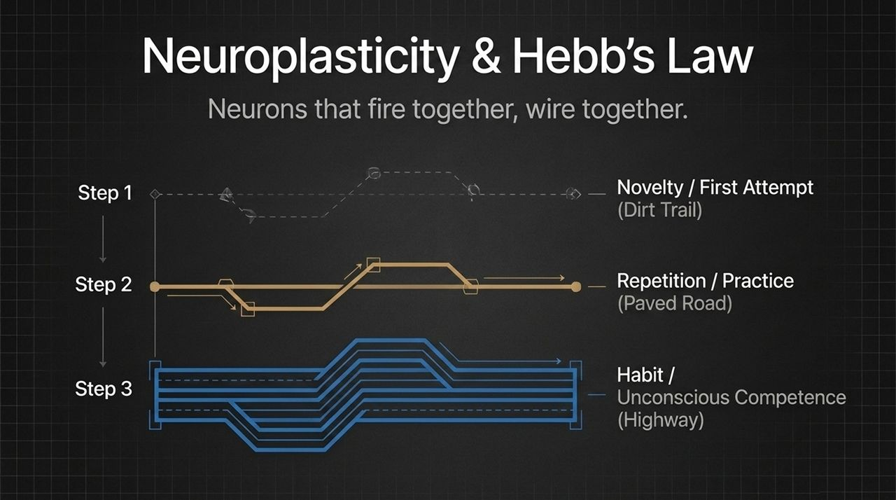
Notes:
For decades, old science claimed that the adult brain was static—that after a certain age, you were stuck with the brain you had. We now know that neuroplasticity proves the exact opposite: your brain is constantly reshaping itself based on how you use it.
The foundational rule here is Hebb’s Law: 'Neurons that fire together, wire together.' Look at the three-step progression on this slide:
Step 1 is Novelty (The Dirt Trail): When you attempt a skill or thought pattern for the first time—like brushing your teeth with your non-dominant hand or learning a new communication technique—it feels awkward and slow. You are hacking through dense forest to create a faint dirt trail.
Step 2 is Repetition (The Paved Road): As you practice repeatedly, myelin wraps around those neural pathways, insulating them and accelerating signal speed. The dirt trail becomes a smooth, paved road.
Step 3 is Habit / Unconscious Competence (The Highway): With sustained practice, that pathway becomes an automatic superhighway. You no longer have to consciously think about executing the behavior; it flows naturally. Whether building positive habits or unlearning negative ones, neuroplasticity is your superpower.

Slide 5
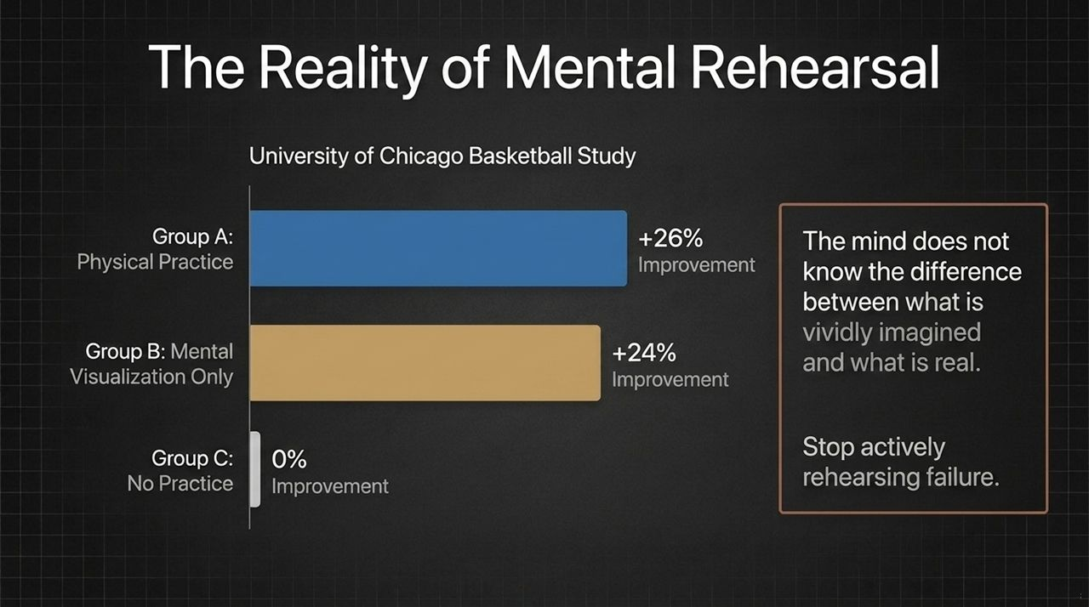
Notes:
How powerful is your mind’s ability to reshape reality? Consider a classic University of Chicago study on basketball free-throw performance.
Researchers split participants into three groups:
Group A engaged in physical practice every day for 30 days. They improved their shot accuracy by 26%.
Group C did zero practice for 30 days. Unsurprisingly, their improvement was 0%.
Group B did not touch a basketball for 30 days. Instead, they spent 30 minutes a day purely visualizing themselves making successful shots in their minds. Their improvement? 24%—a mere 2% difference from physical practice!
Why does this happen? Because the brain does not know the difference between a vividly imagined experience and a real one. Neural pathways fire during visualization almost identically to physical execution.
The Critical Takeaway: Most people spend their days actively rehearsing failure! They visualize stuttering during a presentation, forgetting their client's name, or blowing a key conversation. When you do that, you are literally training your brain to fail. Stop rehearsing your fears; start visualizing the exact habits and actions that make success inevitable.

Slide 6
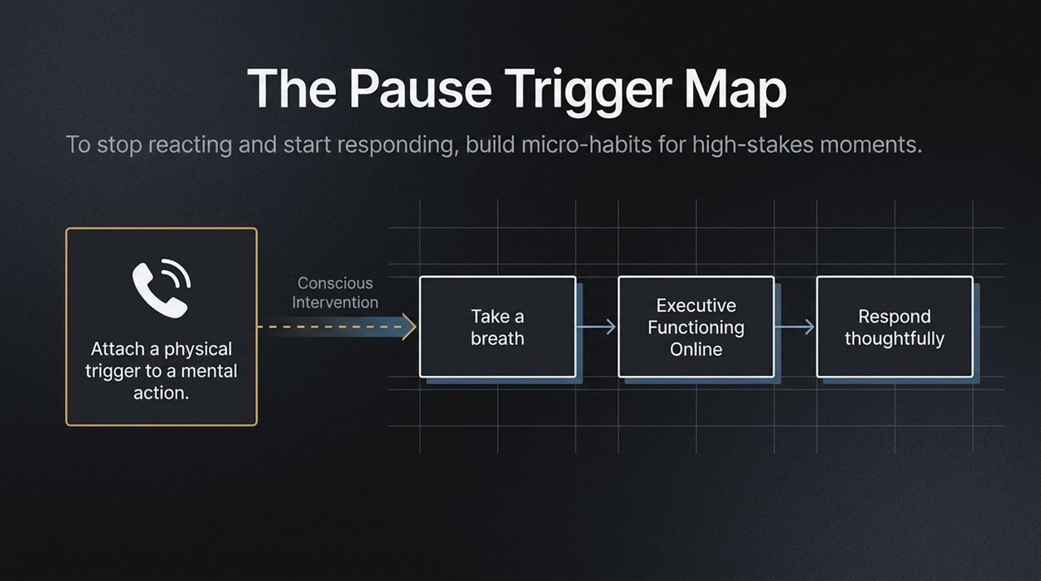
Notes:
To move from reactive emotional outbursts to deliberate, thoughtful responses, we must insert a conscious gap between stimulus and response. As Viktor Frankl famously noted, in that space lies our power to choose.
Jim Kwik shares a powerful technique called the Pause Trigger Map. Habits require triggers. Instead of waiting for a high-stress moment to magically remember to stay calm, attach physical triggers in your everyday environment to train your pause muscle.
Everyday Triggers: Train yourself so that every time you reach for a door handle, or every time your phone rings, you force yourself to take a one-second pause and a deep breath before responding.
Visual Interruption: When someone starts getting heated in a difficult conversation, imagine a giant red 'Pause Button' appearing right on their forehead. Not only does this introduce a slight moment of humor to break your physiological stress state, but it enforces a rule: You cannot speak until you mentally press that pause button.
By consciously intervening with a single breath, you disengage the amygdala and bring your prefrontal cortex back online, allowing you to respond thoughtfully instead of reacting impulsively.

Slide 7
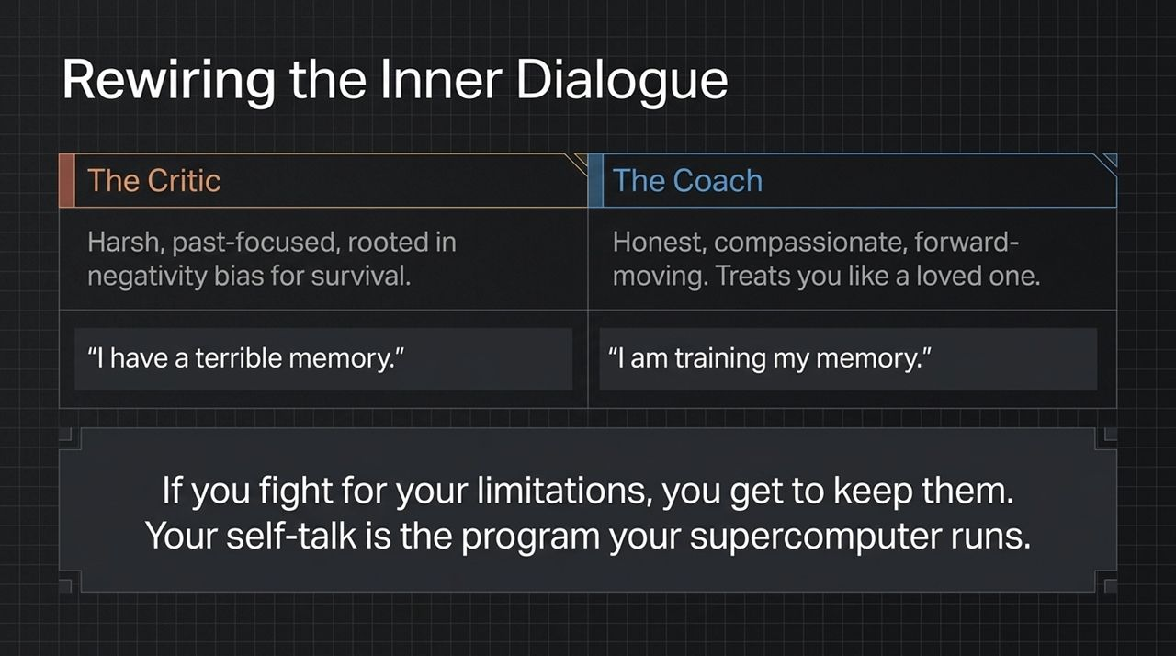
Notes:
Let’s talk about the most important conversation you will ever have: the conversation you have with yourself.
Evolutionary biology gave us a negativity bias. Our brains evolved to keep us alive, not happy. We constantly scan for danger, and as a result, our internal voice often defaults to The Critic—harsh, past-focused, and unforgiving.
Jim Kwik reminds us: 'Your brain is an incredible supercomputer, and your self-talk is the program it runs.' If you run a program that says, 'I have a terrible memory,' or 'I'm awful under pressure,' your supercomputer will actively seek evidence to fulfill that command. Remember: If you fight for your limitations, you get to keep them.
We need to switch from The Critic to The Coach. A coach is not delusional or overly soft; a coach is honest, compassionate, and forward-looking.
Instead of saying: 'I have a terrible memory,'
Reframe it to: 'I am currently training my memory.'
Research on self-compassion shows that treating yourself with grace makes you far more resilient and likely to follow through than beatings from self-criticism ever will.

Slide 8
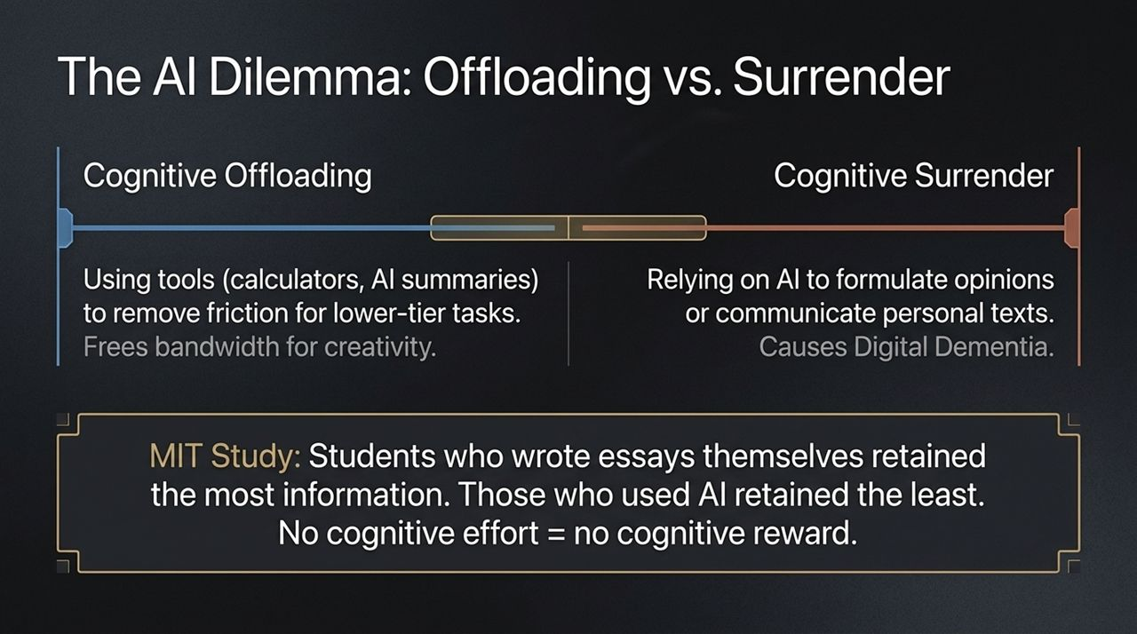
Notes:
Now let's tackle the central question of our modern era: Is AI making our brains weaker or stronger?
To answer this, we must distinguish between two critical concepts: Cognitive Offloading and Cognitive Surrender.
Cognitive Offloading is using tools to remove low-level friction. We use calculators for basic math, or calendars to store meeting times. This frees up precious working memory bandwidth for higher-tier creative thinking.
Cognitive Surrender, however, occurs when you rely on AI to do the actual thinking, opinion-forming, and personal communicating for you. This leads directly to what neuroscientists call Digital Dementia—the breakdown of cognitive faculties due to disuse.
Look at the recent MIT Study mentioned on this slide: Students were tasked with writing essays. Group A used ChatGPT, Group B used standard Google searches, and Group C used no technology. Brain scans showed that Group C had the highest cognitive engagement. But when tested later on recall of their own essay topics, the ChatGPT group retained by far the least!
Why? Because No cognitive effort = No cognitive reward. If you ask someone else at the gym to lift the weights for you, you don't get the muscle growth.

Slide 9
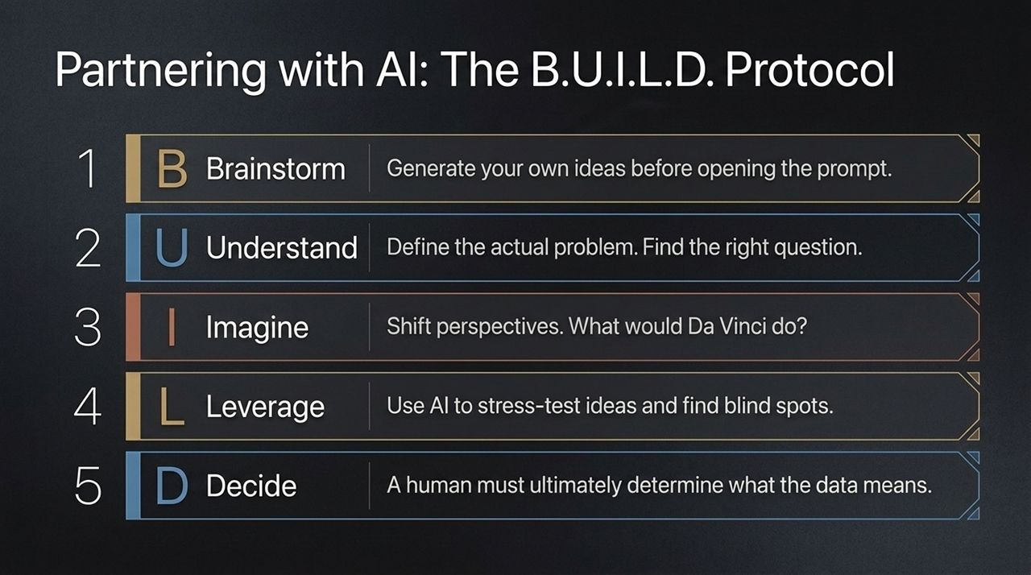
Notes:
We shouldn't reject AI, but we must establish healthy boundaries so it enhances our brain rather than replacing it. Before you open ChatGPT or Claude to write or solve a problem, execute Jim Kwik’s B.U.I.L.D. Protocol:
1. B – Brainstorm: Engage your own neural circuits first. Write down your own thoughts, rough outlines, or ideas before you input a prompt.
2. U – Understand: Define the core problem clearly. As Einstein famously suggested, spend the majority of your time understanding and asking the right question rather than rushing to a surface solution.
3. I – Imagine: Shift perspectives mentally. Ask yourself: 'How would a 5-year-old look at this problem?' or 'What would Leonardo da Vinci do in this scenario?' Forced perspective shifts provoke creative breakthroughs.
4. L – Leverage: Now bring in AI. Use it to stress-test your ideas, find blind spots, play devil's advocate, or distill vast datasets. Treat AI as a brilliant collaborator, not a substitute brain.
5. D – Decide: AI can compute and process faster than us, but a human must ultimately determine what the data means and decide on the proper course of action.

Slide 10
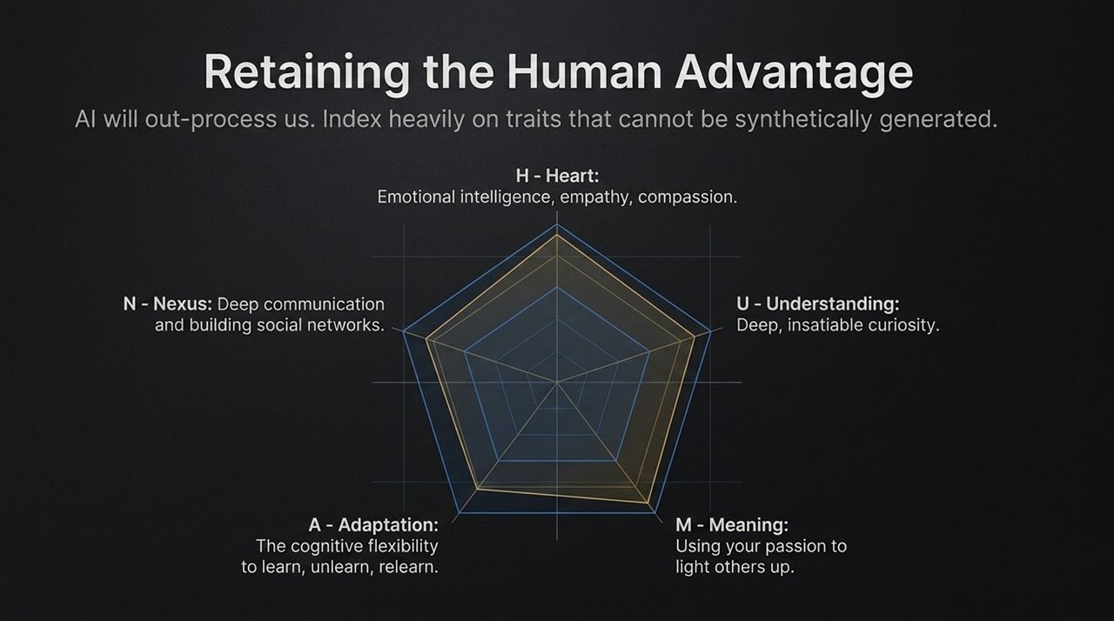
Notes:
AI will inevitably out-process, out-calculate, and out-memorize humans. If you try to compete on raw computation, you will lose. To stay irreplaceable, you must double down on traits that cannot be synthetically duplicated. Focus on the H.U.M.A.N. Pillars:
H – Heart: Emotional intelligence (EQ), empathy, compassion, and authentic human connection. AI can simulate polite sentences, but it cannot genuinely care.
U – Understanding: Insatiable curiosity. High performers are driven by deep curiosity that unlocks hidden insights.
M – Meaning: Purpose and passion. Passion is what lights you up; purpose is using your passion to light others up.
A – Adaptation: Cognitive flexibility—the ability to learn, unlearn, and relearn rapidly as the landscape shifts.
N – Nexus: Deep communication, trust-building, and social relationships. Humans will always seek genuine human leadership and lived experience.

Slide 11
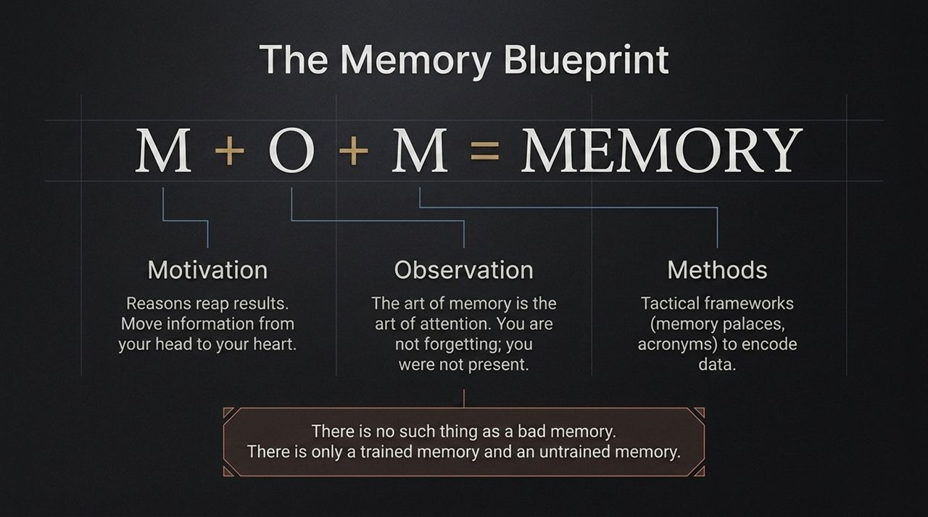
Notes:
How many times have you claimed, 'I'm just bad with names,' or 'I have a horrible memory'?
Jim Kwik insists: 'There is no such thing as a good or bad memory. There is only a trained memory and an untrained memory.' School taught us what to learn, but never how to learn.
The core formula for unlocking memory is $M+O+M=MEMORY$:
1. Motivation: Reasons reap results. If I offered you a million dollars to remember the next person's name you meet, you would remember it effortlessly. Why? Because your motivation shifted instantly. To remember something, connect the information from your head to your heart.
2. Observation: The art of memory is the art of attention. Most of the time when you 'forget' a name or fact, you didn't forget it—you simply were not present when it was spoken. You were thinking about your response or scanning the room.
3. Methods: Tactical encoding tools, such as the Memory Palace or spatial visualization, to lock information into long-term structures.

Slide 12
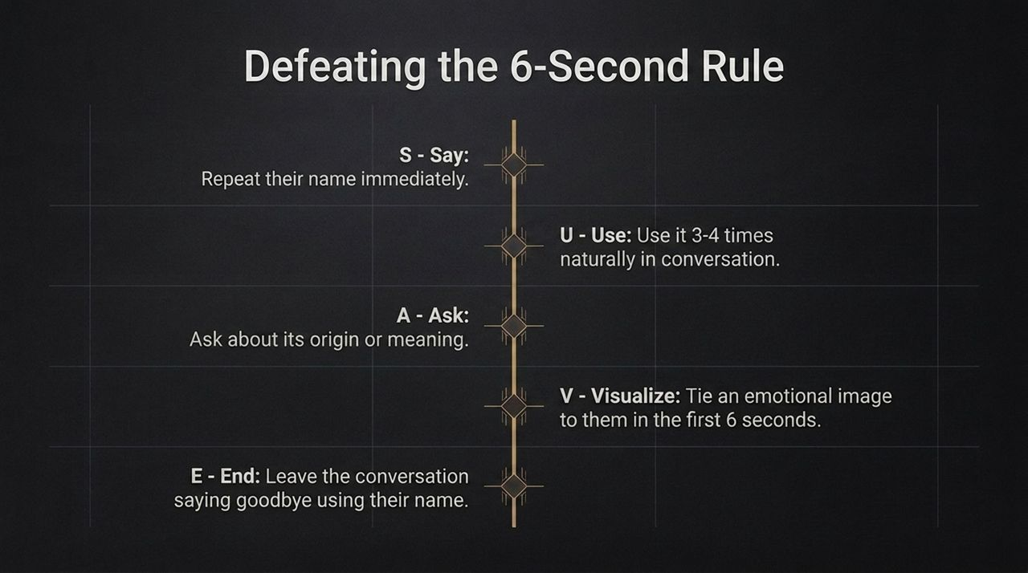
Notes:
When you meet someone new, you have roughly 6 seconds to encode their name before it evaporates from working memory. To conquer this, use the S.U.A.V.E. protocol:
S – Say: Repeat their name immediately upon introduction. 'Nice to meet you, Jefferson.' This confirms you heard it correctly.
U – Use: Use their name 3 to 4 times naturally in your conversation. (Avoid overusing it to the point where it sounds bizarre!)
A – Ask: If it’s an unfamiliar or unique name, ask about its origin, spelling, or meaning. People love discussing their background, and it gives you additional contextual anchors.
V – Visualize: Create a vivid, funny visual image in your mind during those first 6 seconds. If you meet someone named Chef, picture them in a giant chef's hat; if named David, imagine David and Goliath with a slingshot. The sillier the image, the stronger the memory hook.
E – End: End the interaction by using their name one final time: 'Goodbye, Jefferson.' If you walk out of a room of 10 strangers and say goodbye to each by name, you will be unforgettable.

Slide 13
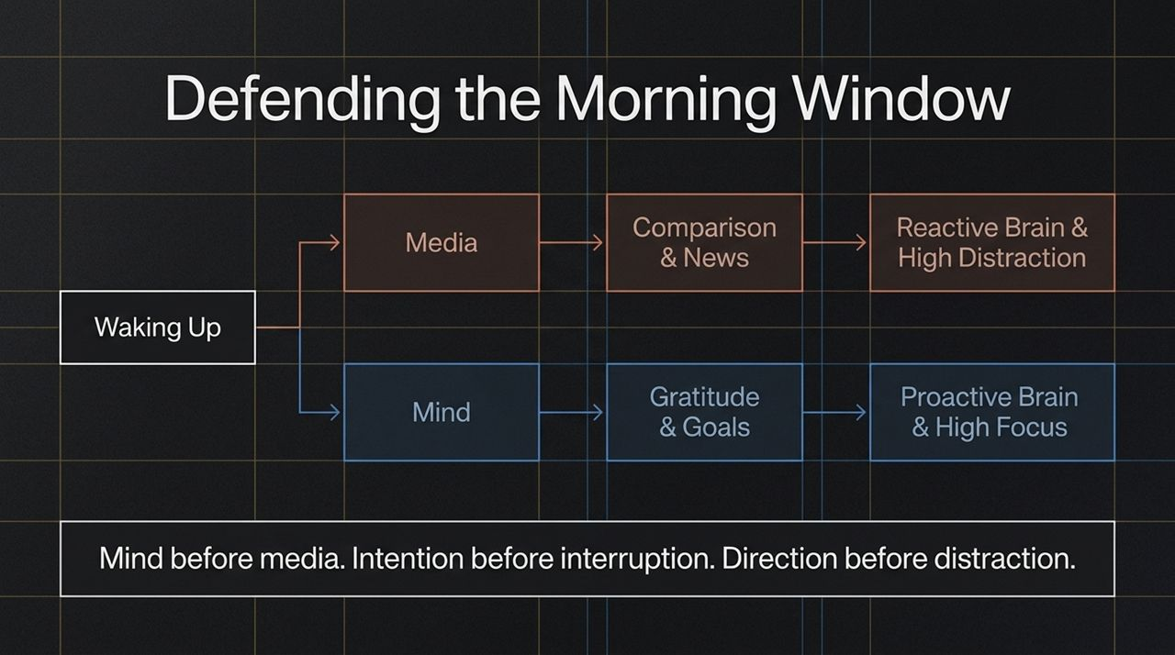
Notes:
When you wake up in the morning, your brain transitions out of sleep through a state called sleep inertia. During this window, your brain waves move from delta to theta to alpha. Your working memory is completely clear and hyper-suggestible.
What you input during this period has a massive, disproportionate effect on your focus, emotional state, and framing for the entire day.
The Reactive Path: Most people grab their smartphones within seconds of opening their eyes. They flood their brain with emails, headlines, social media alerts, and outrage. This trains your brain to be hyper-reactive, anxious, and easily distracted before you even get out of bed.
The Proactive Path: Practice Mind Before Media. Protect your first hour. Dedicate this window to intentional inputs: gratitude, goal visualization, reading, or quiet reflection.
Remember the mantra: Mind before media. Intention before interruption. Direction before distraction.

Slide 14
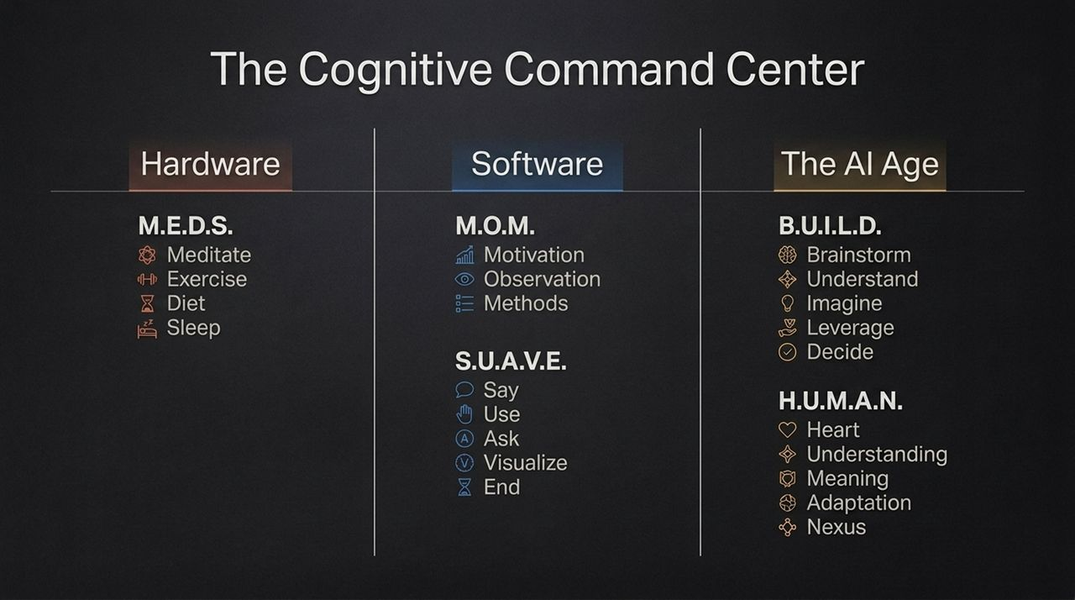
Notes:
This slide brings our entire ecosystem together into a single Cognitive Command Center. Think of your mind operating across four core domains:
Hardware (M.E.D.S.): Meditate, Exercise, Diet, Sleep. Keep your physical biological organ healthy, hydrated, and neurochemically balanced.
Software (M.O.M. & S.U.A.V.E.): Drive motivation, hone active observation, and apply tactical encoding tools like S.U.A.V.E. for names and communication recall.
The AI Age (B.U.I.L.D.): Avoid cognitive surrender. Brainstorm, Understand, Imagine, Leverage, and Decide. Use technology as an external engine, not as your core driver.
Human Advantages (H.U.M.A.N.): Invest heavily in Heart, Understanding, Meaning, Adaptation, and Nexus networks.
When you systematically optimize these four areas, you build an unstoppable, resilient cognitive edge that thrives under any environmental pressure.

Slide 15
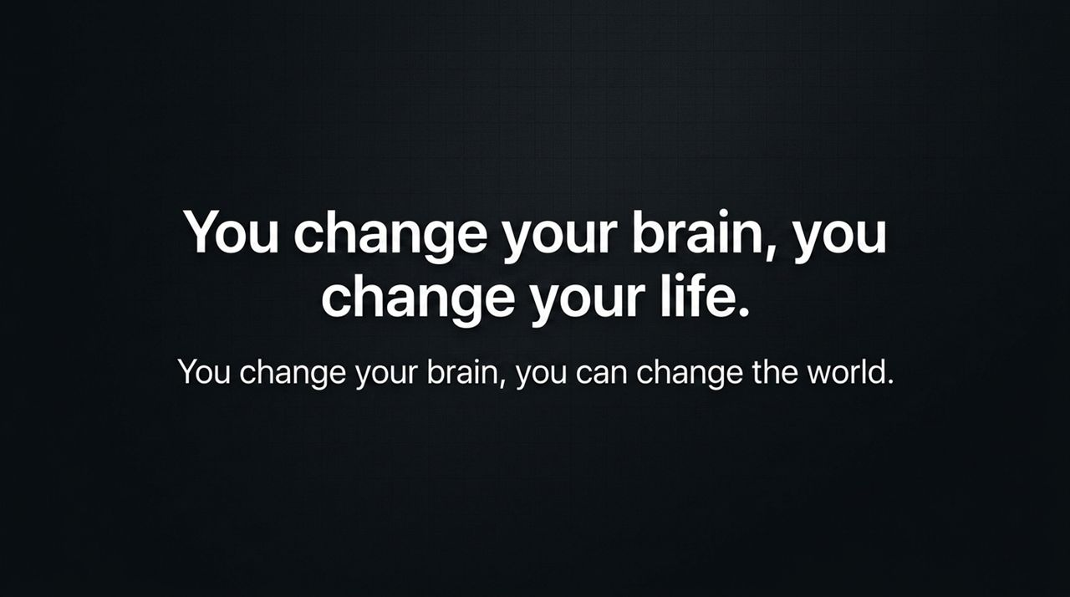
Notes:
As we near the end of our deck, let’s reflect on why this work matters.
It is easy to view memory, speed reading, or focus exercises as mere self-improvement productivity hacks. But in reality, your brain is the lens through which you experience every second of your existence.
When you upgrade your brain, you change your decisions. When you change your decisions, you change your career, your relationships, your health, and your financial future.
As Jim Kwik beautifully summarizes: 'You change your brain, you change your life. You change your brain, you can change the world.'
Never accept artificial limitations placed on you by past injuries, harsh labels from teachers or bosses, or self-critical inner monologue. Your brain possesses staggering plasticity—you simply need to step into driver's seat and run the right programs.

Slide 16
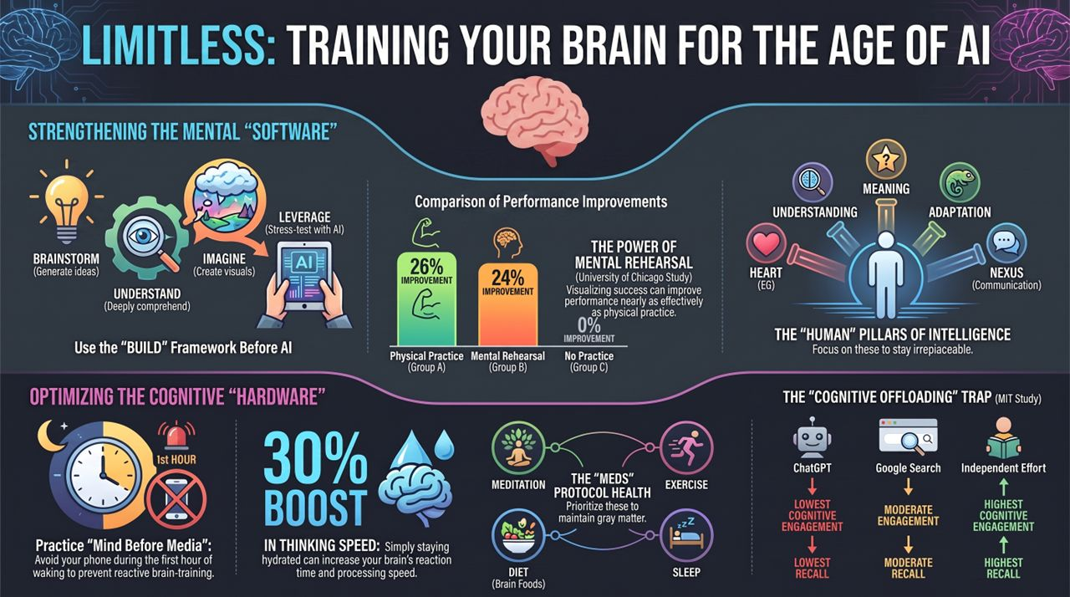
Notes:
To conclude our session, Slide 16 serves as your complete single-page executive summary. Let’s review the critical highlights to lock them into memory:
Hardware Optimization: Prioritize the M.E.D.S. protocol (Meditation, Exercise, Diet, Sleep) to build and protect gray matter. Hydrate immediately upon waking for an instant boost in processing speed.
The First Hour: Practice 'Mind Before Media' during the morning sleep inertia window. Avoid reactive scrolling to keep your working memory focused and proactive.
Mental Rehearsal Power: Remember the Chicago free-throw study—mental visualization alone created a 24% improvement. Rehearse your success and key actions daily, not your fears.
Avoid the AI Trap: Don't fall into cognitive surrender. Independent effort yields maximum cognitive engagement and recall, whereas relying purely on AI offloading yields the lowest recall. Always apply B.U.I.L.D. before turning to AI.
H.U.M.A.N. Pillars: Double down on Heart, Understanding, Meaning, Adaptation, and Nexus to remain irreplaceable.
Thank you for your time and focus today. Take these frameworks, apply them daily, and reclaim your cognitive edge!

